Slide 1
Chapter 11 - Fine-Tuning Representation Models for Classification
From the book Hands-On Large Language Models

Slide 2
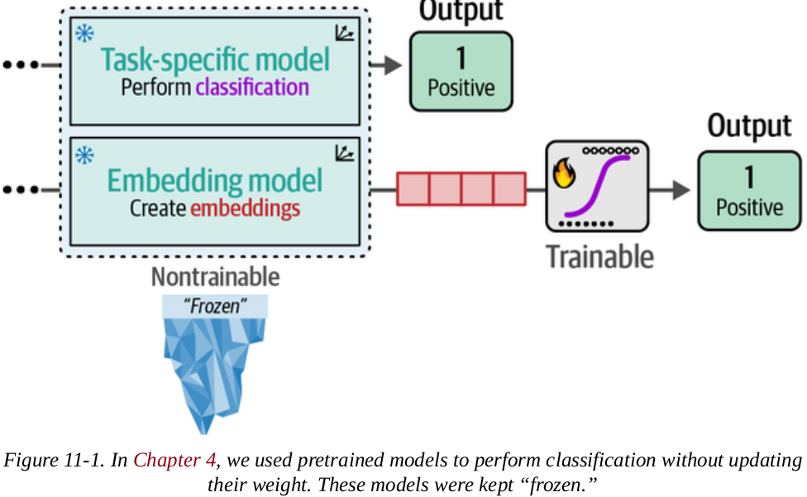
Supervised Classification
Previously, we finetuned pretrained models to perform specific tasks (sentiment prediction).
We kept the pretrained model frozen (nontrainable), not updating its weights and just fine-tuning the classification head.

Slide 3
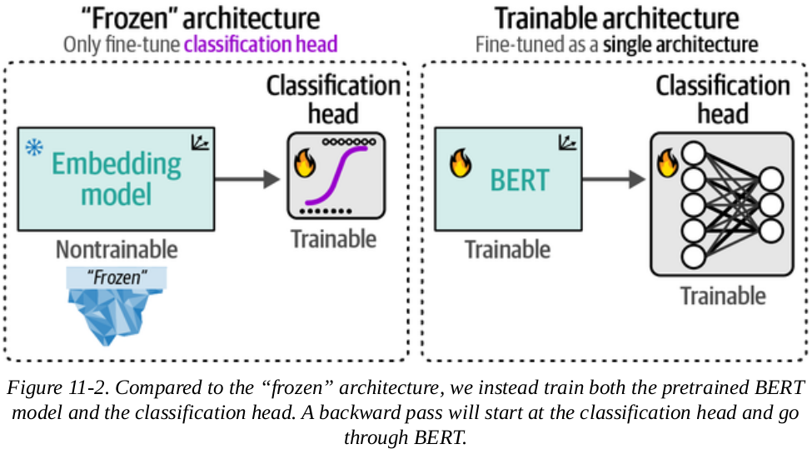
Supervised Classification
Here, we will treat the pretrained model and the classification head as one architecture during training,
This allows the pretrained model to change its weights and parameters

Slide 4
Supervised Classification
Here, we will treat the pretrained model and the classification head as one architecture during training,
This allows the pretrained model to change its weights and parameters

Slide 5
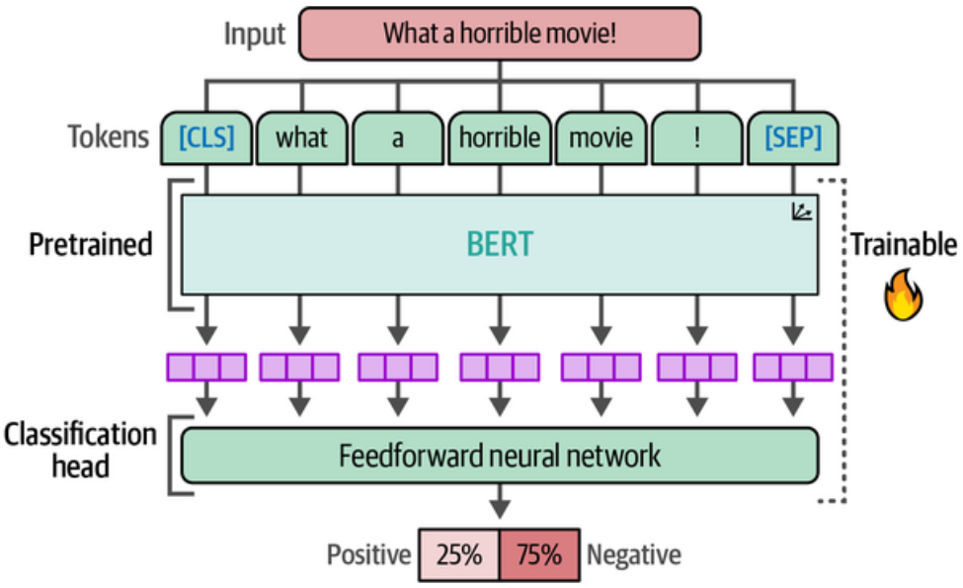
Supervised Classification
We will use the bert-base-cased model as our pretrained model and train it with a classification head (neural network).
This means that the classification head and the pretrained model are both updated during the training.

Slide 6
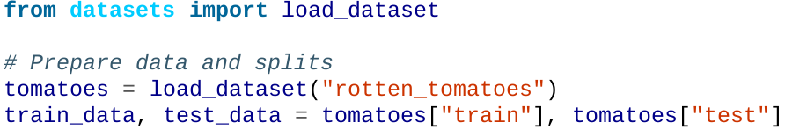
Fine-Tuning a Pretrained BERT Model
We will use the same Rotten Tomatoes dataset, which contains 5,331 positive and 5,331 negative movie reviews.

Slide 7
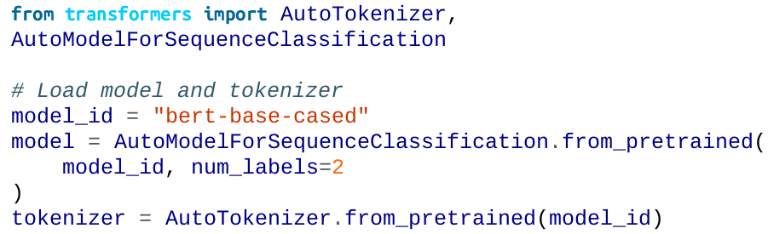
Fine-Tuning a Pretrained BERT Model
As mentioned above, we use bert-base-cased as the pretrained model. This model was pretrained on the English Wikipedia and a large dataset of unpublished books.

Slide 8
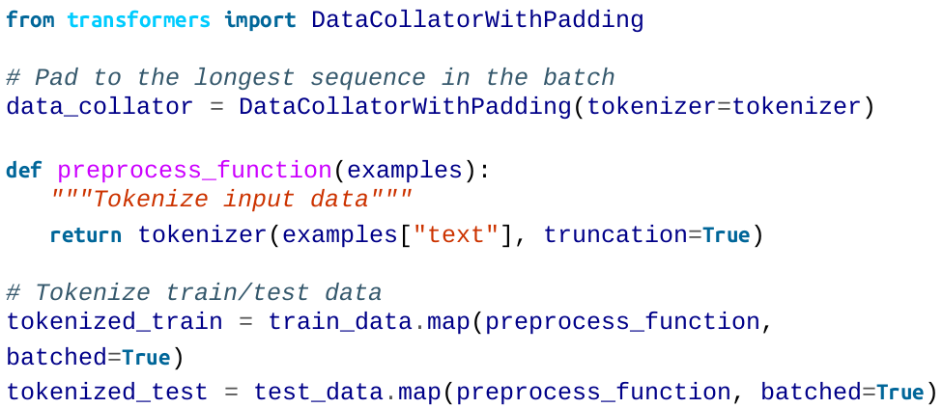
Fine-Tuning a Pretrained BERT Model
Now that the model and the tokenizer have been loaded, we will tokenize the data:

Slide 9
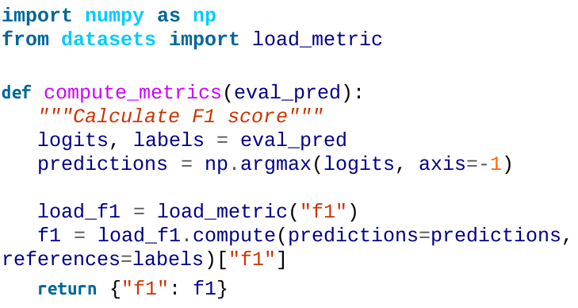
Fine-Tuning a Pretrained BERT Model
Before creating the Trainer, we will want to prepare a special DataCollator .
A DataCollator is a special class that helps us build batches of data but also allows us to apply data augmentation.
To create equally sized representations, we use DataCollatorWithPadding .

Slide 10
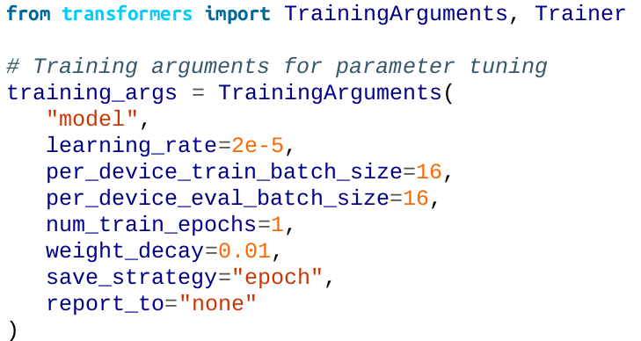
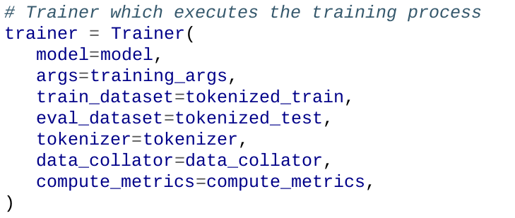
Fine-Tuning a Pretrained BERT Model
The TrainingArguments class defines hyperparameters we want to tune, like the learning rate and the number of epochs.
Next, we instantiate the Trainer :

Slide 11
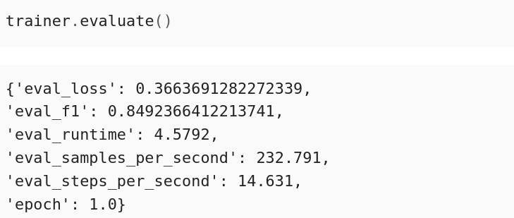
Fine-Tuning a Pretrained BERT Model
Let’s evaluate the trainer:
We get an F1 score of 0.85, higher than that of the task-specific model (0.80) from Chapter 4.

Slide 12
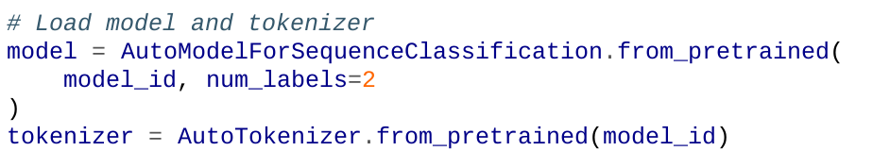
Freezing Layers
To further showcase the importance of training the entire network, we will freeze the main BERT model and allow training only for the classification head. This will allow for good comparisons.

Slide 13
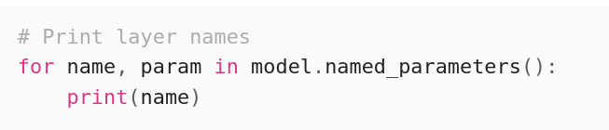
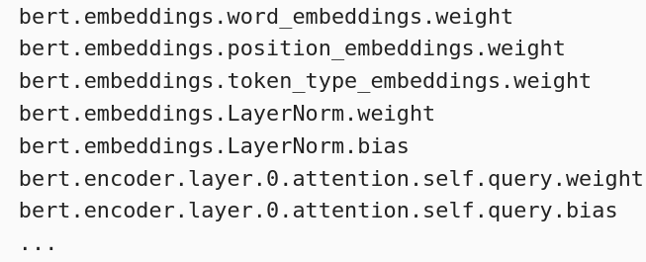
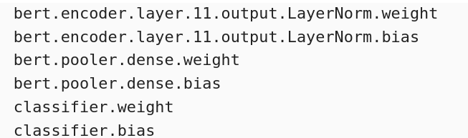
Freezing Layers
By inspecting the layers of the model we can see which layers we might want to freeze:

Slide 14
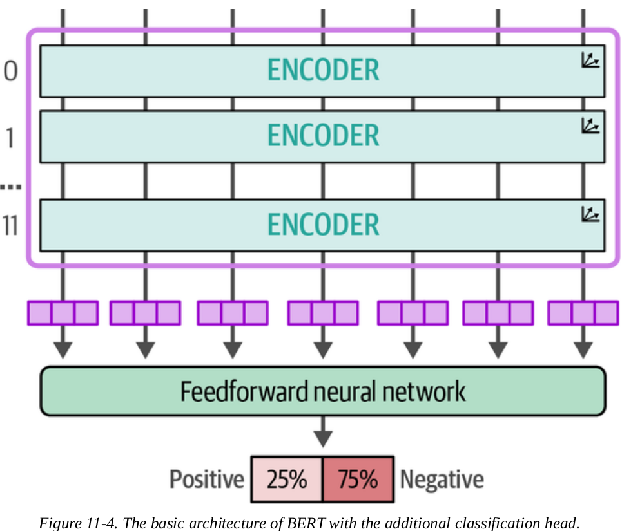
Freezing Layers
There are 12 (0-11) encoder blocks consisting of attention heads, dense networks, and layer normalization.

Slide 15
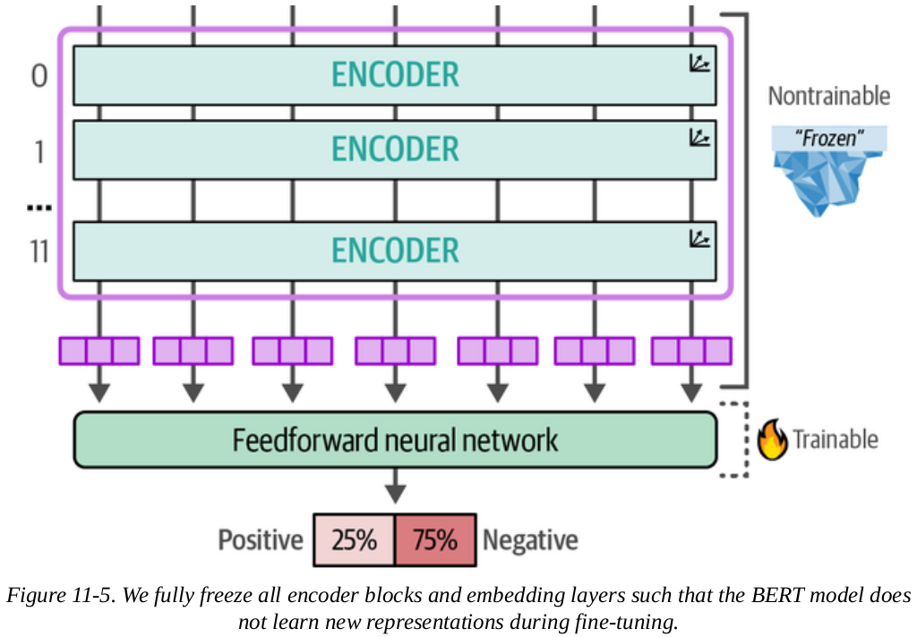
Freezing Layers
We are going to freeze everything but the classification head, as in chapter 2.

Slide 16
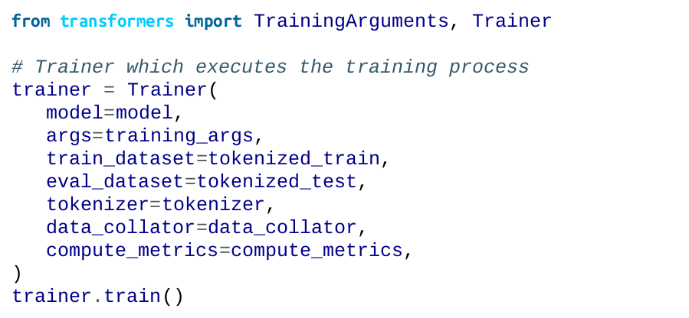
Freezing Layers
After freezing the model, we can start with the training:

Slide 17
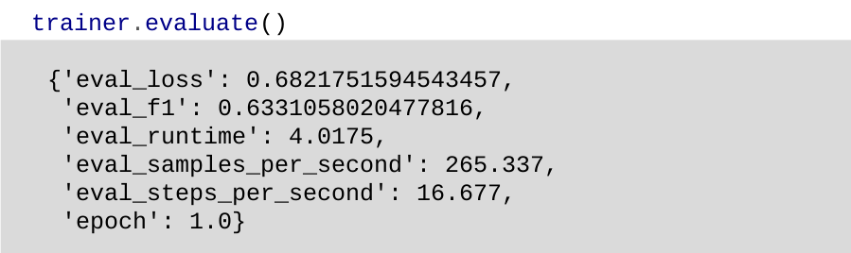
Freezing Layers
Let's evaluate the model after training of 1 epoch:
As you can see, we get an F1 score of 0.63.

Slide 18
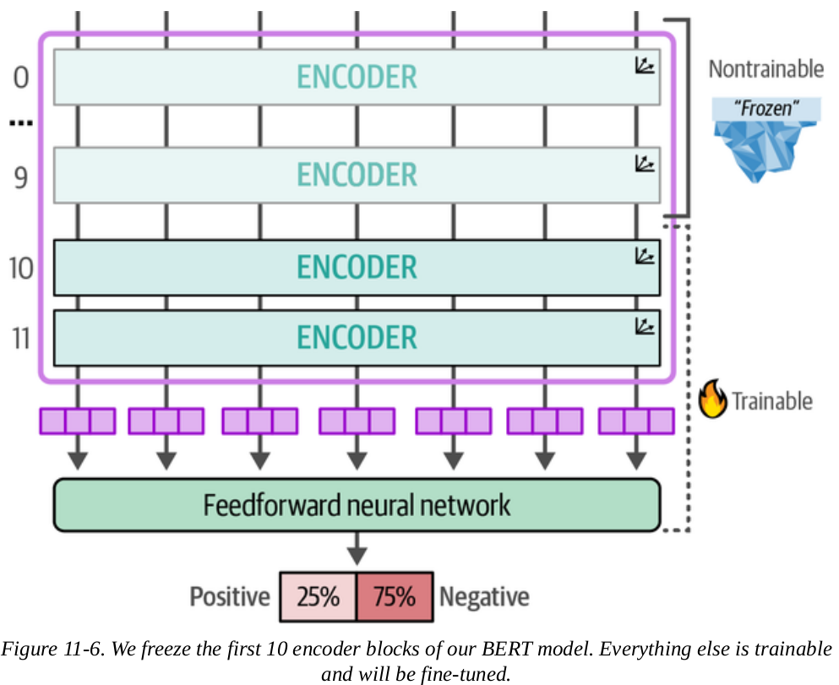
Freezing Layers
So instead of freezing all layers of the model, let's freeze everything up until encoder block 10 and see how this affects performance.
This is illustrated:

Slide 19
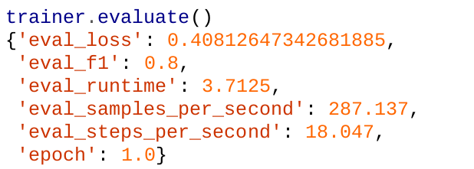
Freezing Layers
Let's evaluate the results:
The F1 score this time is 0.8, much higher than the previous 0.63 when freezing all the layers. This shows that training less is sufficient if the necessary computing power is not available.

Slide 20
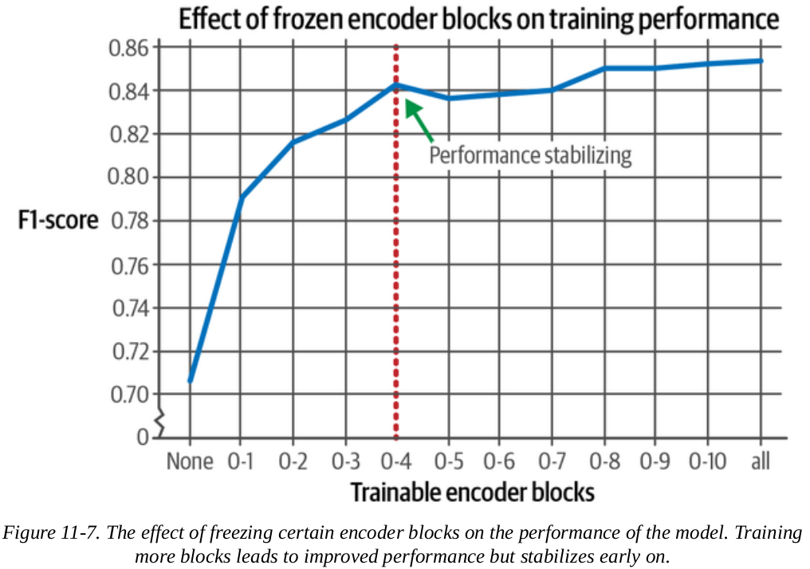
Freezing Layers
Training only the first five encoder blocks is enough to almost reach the performance when all encoder blocks are trained.
See the diagram for reference.

Slide 21
SetFit: Efficient Fine-Tuning with Few Training Examples
SetFit is built on top of the sentence-transformers architecture to generate high quality textual representations that are updated during training. The algorithm of SetFit consists of 3 steps:
1. Sampling training data
Based on in-class and out-class selection of labeled data it generates positive (similar) and negative (dissimilar) pairs of sentences
2. Fine-tuning embeddings
Fine-tuning a pretrained embedding model based on previously generated training data
3. Training a classifier
Create a classification head on top of the embedding model and train it using the previously generated training data

Slide 22
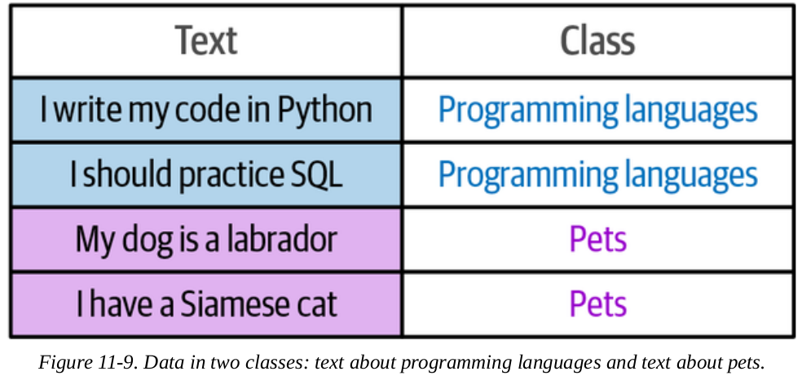
SetFit: Efficient Fine-Tuning with Few Training Examples
Before fine-tuning an embedding model, we need to generate training data.
The model assumes the training data to be samples of positive (similar) and negative (dissimilar) pairs of sentences.
But the input data we have is generally not labeled as such.

Slide 23
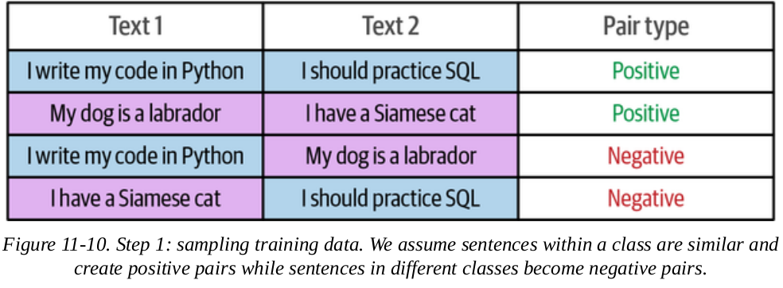
SetFit: Efficient Fine-Tuning with Few Training Examples
In step 1, SetFit handles this by pairing all sentences of one class with those of the other.
So imagine you have 16 sentences about sports, we can create 16*(16-1) / 2 = 120 pairs that we label as positive pairs.
Same process is used for generating negative (dissimilar) pairs.

Slide 24
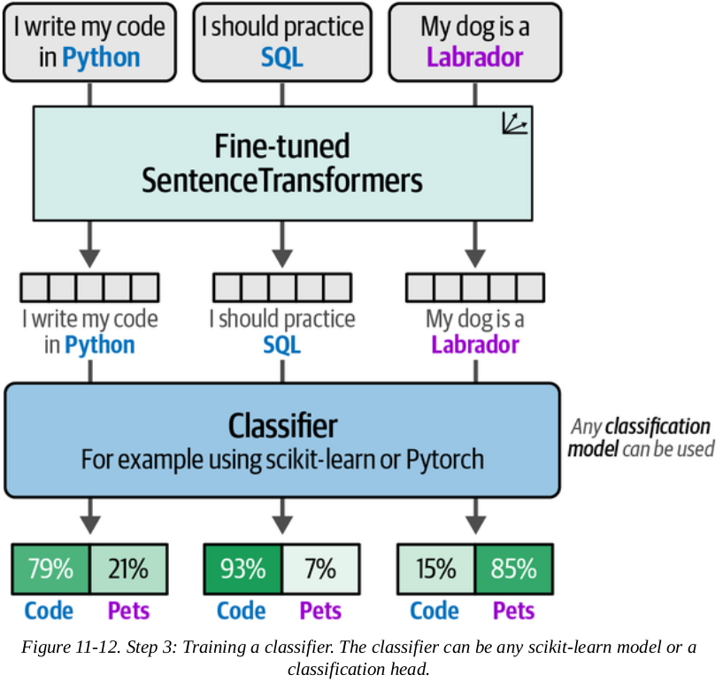
SetFit: Efficient Fine-Tuning with Few Training Examples
In step 3, we generate embeddings for all sentences and use those as the input of a classifier.
We use the sentence-transformers model we finetuned to convert the sentences into embeddings

Slide 25
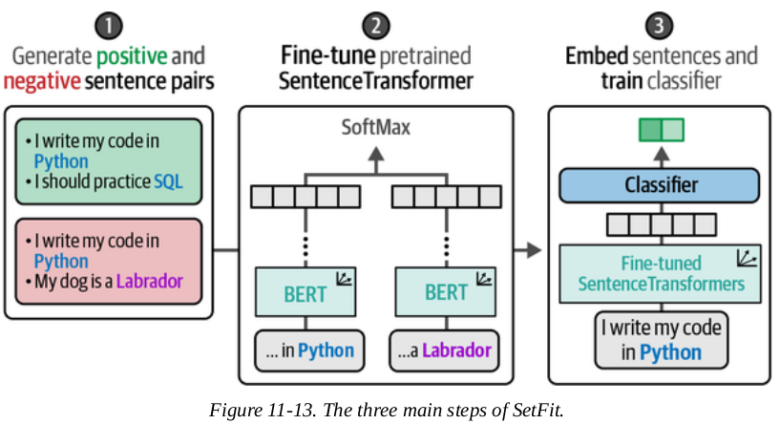
SetFit: Efficient Fine-Tuning with Few Training Examples
The three main steps of SetFit is illustrated in the diagram:

Slide 26
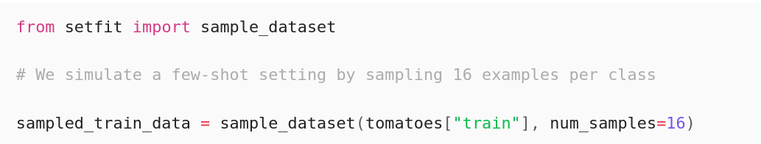
Fine-Tuning for Few-Shot Classification
Since this is few-shot, we only use 16 examples per class (32 in total) of the 8,500 movie reviews

Slide 27
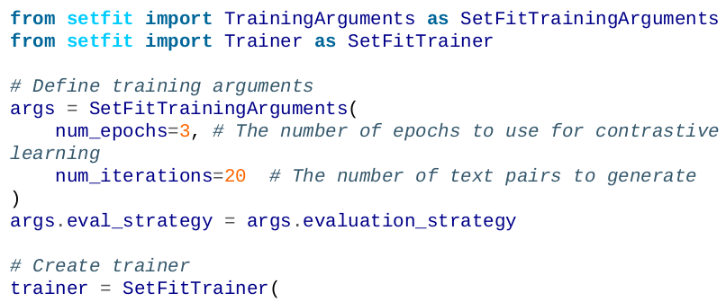
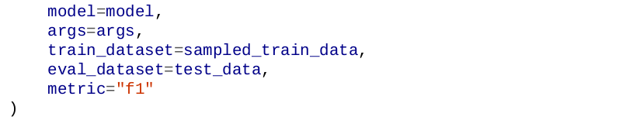
Fine-Tuning for Few-Shot Classification
After loading the pretrained SentenceTransformer model, we define the SetFitTrainer

Slide 28
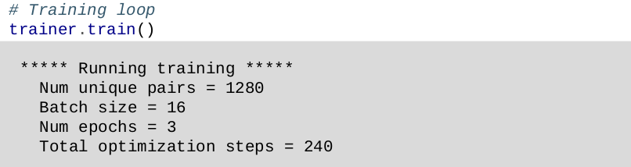
Fine-Tuning for Few-Shot Classification
We only need to call train to start the training loop. When we do, we should get the following output:
Notice that the number of unique pairs in the output is 1,280. This is because, by default, 20 sentence pair combinations are generated for each sample in data.
So 20 * 32 = 680 multiplied by 2 (for negative and positive pairs).

Slide 29
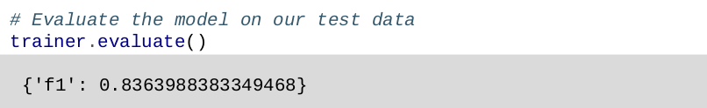
Fine-Tuning for Few-Shot Classification
Let's now evaluate the model:
We get an F1 score of 0.85.
This is impressive for a model trained on only 32 labeled documents.

Slide 30
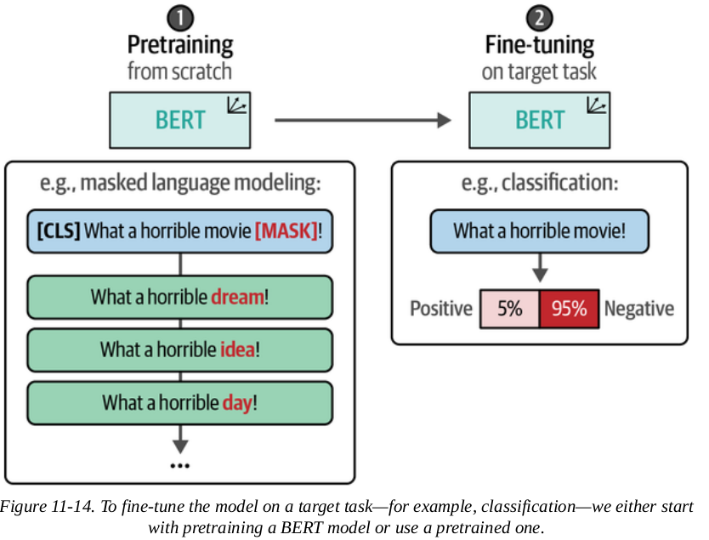
Continued Pretraining with Masked Language
So far, we have used a pretrained model and finetuned it.

Slide 31
Continued Pretraining with Masked Language
This is a two-step process:
1. Pretraining a model (already done for us)
2. Fine-tuning it for a particular task
However, since these models are pretrained on very general data (e.g., Wikipedia), it is not tuned to domain-specific words.
To address this, an extra step is added between these two steps. It is continue pretraining an already pretrained BERT model.
We simply continue training the BERT model using masked language modeling (MLM).

Slide 32
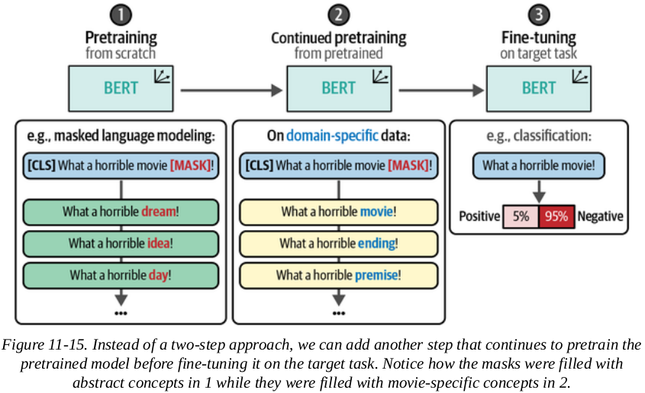
Continued Pretraining with Masked Language
The data used to train it are domain-specific.
The advantage of this is that it doesn't require pretraining from scratch.

Slide 33
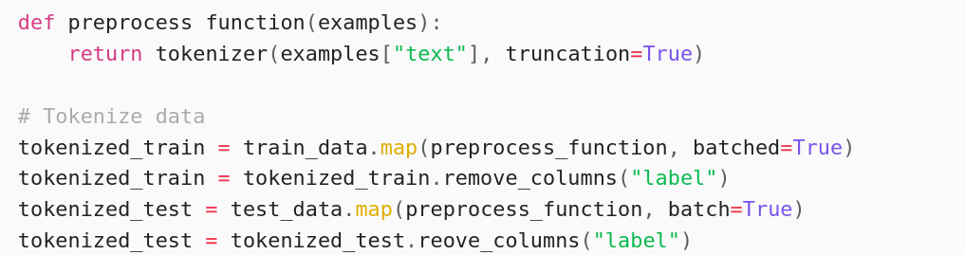
Continued Pretraining with Masked Language
We need to tokenize the raw sentences and remove the labels since this is not a supervised task:

Slide 34
Continued Pretraining with Masked Language
Previously, we used DataCollatorWithPadding , which dynamically pads the input it receives.
Now, we use DataCollator that will perform the masking of tokens for us.
There are generally two methods of masking used:
1. Token masking: randomly mask 15% of the tokens in a sentence. A part of a word could be
masked.
2. Whole-word masking: To avoid masking just a part of a word, we use whole-word masking

Slide 35
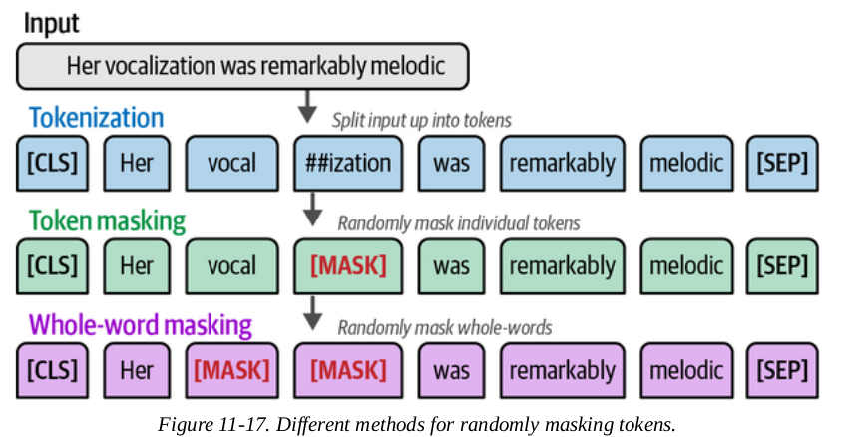
Continued Pretraining with Masked Language
Predicting whole words is more complicated than tokens, which makes the model perform better as it needs to learn more accurate and precise representations during training.
But it tends to take a bit more time to converge.

Slide 36
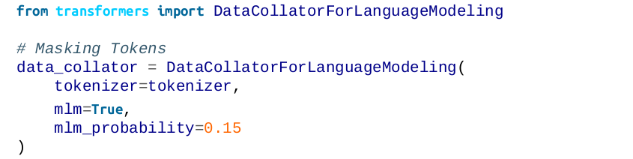
Continued Pretraining with Masked Language
We will be going with token masking and use DataCollatorForLanguageModeling for faster convergence.
For whole-word masking, you can use DataCollatorForWholeWordMask
Lastly, we set the percentage of masked tokens to 15%:

Slide 37
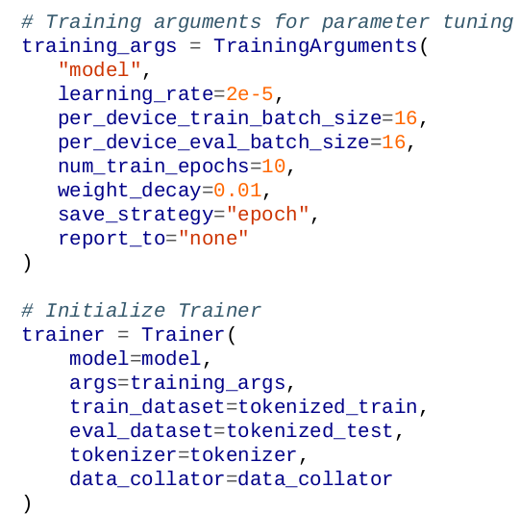
Continued Pretraining with Masked Language
Next, we will create the Trainer for running the MLM task and specify certain parameters:

Slide 38
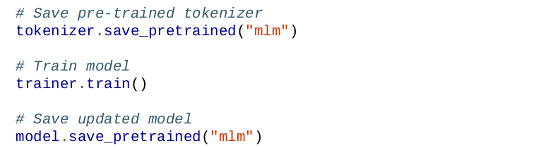
Continued Pretraining with Masked Language
After we continue pretraining, we save the pretrained tokenizer.
This gives us an updated model in the mlm folder.

Slide 39
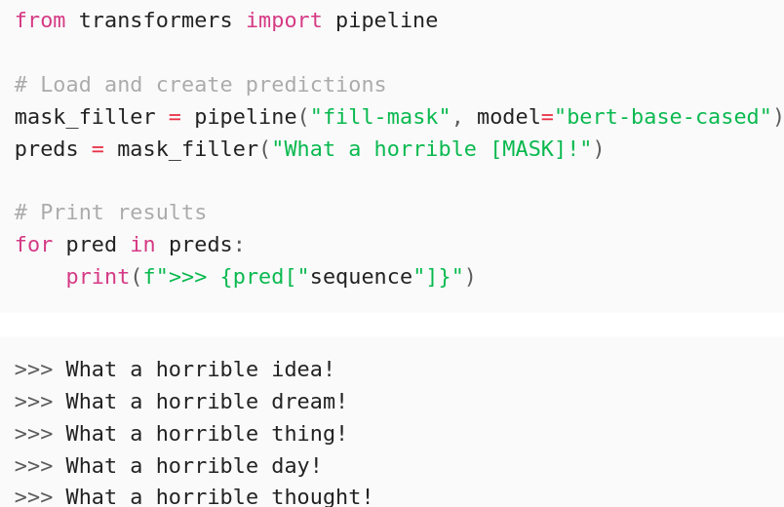
Continued Pretraining with Masked Language
We will run some masking tasks to see if it has learned from its continued training.

Slide 40
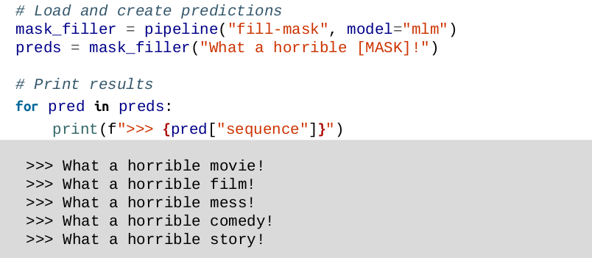
Continued Pretraining with Masked Language
Next, let’s see what our updated model predicts:
As you can see, the model now generates words from the data we trained it on (Rotten Tomatoes reviews dataset).

Slide 41
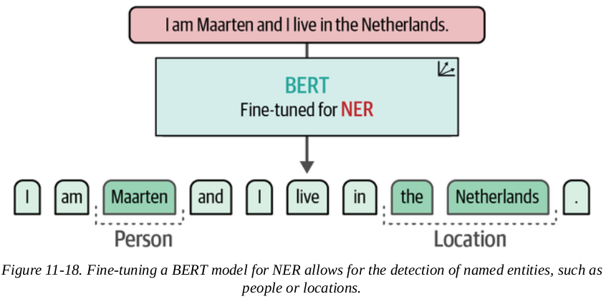
Named-Entity Recognition
Unlike typical classification of entire documents or texts, Named-Entity Recognition involves identifying tokens and/or words of entities (names, places, events, etc.)
This is helpful for de-identification and anonymization tasks when there are sensitive data.

Slide 42
Preparing Data for Named-Entity Recognition
In this example, we will use the English version of the ConLL-2003 dataset, which contains several different types of named entities (person, organizations, etc.) and has roughly 14,000 training samples.

Slide 43
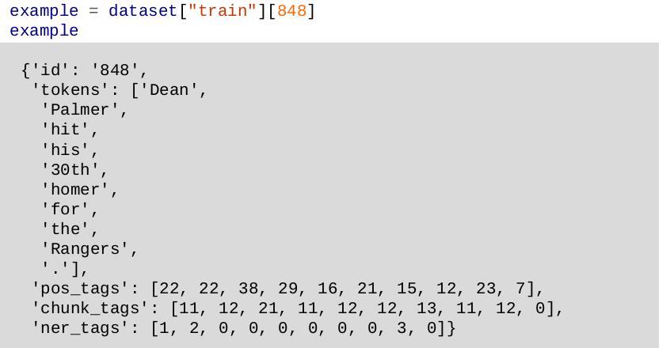
Preparing Data for Named-Entity Recognition
Let’s inspect the structure of the data with an example:

Slide 44
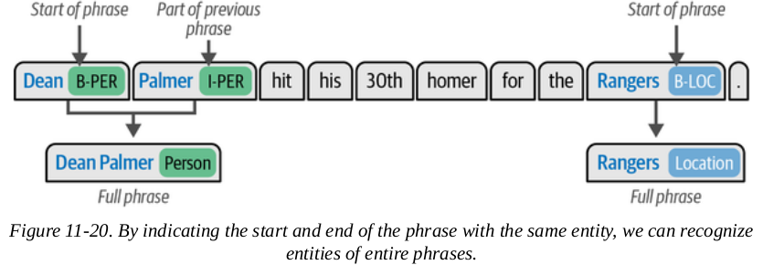
Preparing Data for Named-Entity Recognition
If two tokens that follow each other are part of the same phrase, then the start of that phrase is indicated with B, which is followed by an I to show that they belong to each other and are not independent entities.

Slide 45
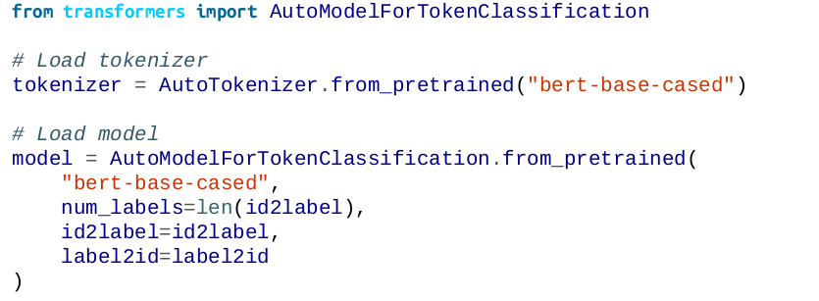
Preparing Data for Named-Entity Recognition
We now tokenize the words with the tokenizer of the pretrained model bert-base-cased:

Slide 46
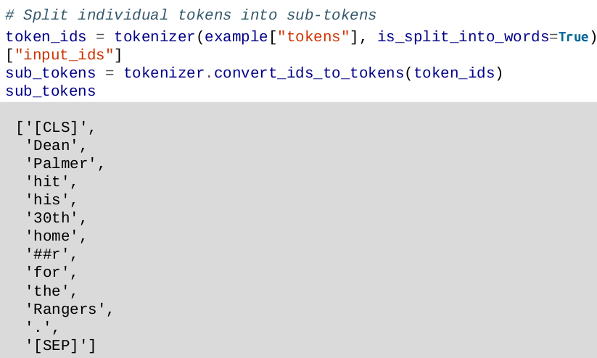
Preparing Data for Named-Entity Recognition
Let's explore how the tokenizer would process our example:

Slide 47
Preparing Data for Named-Entity Recognition
Note that the word 'homer' was further split up into the tokens 'home' and '##r'
This creates a bit of a problem for us since we have labeled data at the word level but not at the token level
This can be resolved by aligning the labels with their subtoken counterparts during tokenization.

Slide 48
Preparing Data for Named-Entity Recognition
Let's consider the word 'Maarten', which has the label B-PER to signal that this is a person.
If we pass that word through the tokenizer, it splits the word up into the tokens 'Ma', '##arte', and '##n'.
We cannot use the B-PER entity for all tokens as that would signal that the three tokens are all independent people.
Whenever an entity is split into tokens, the first token should have B (for beginning) and the following should be I (for inner).

Slide 49
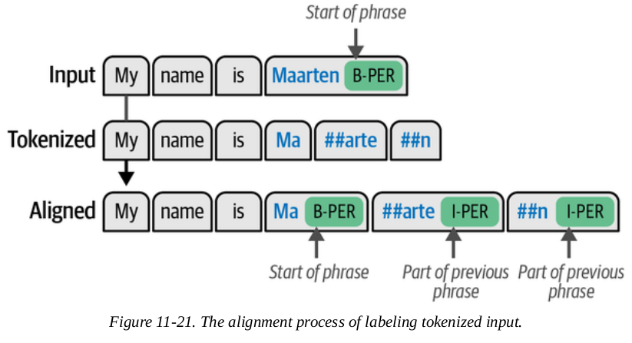
Preparing Data for Named-Entity Recognition
Therefore, 'Ma' will get the B-PER to signal the start of a phrase, and '##arte', and '##n' will get the I-PER to signal they belong to a phrase.

Slide 50
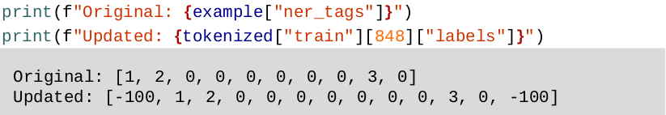
Preparing Data for Named-Entity Recognition
We create a function, align_labels (see the notes/book, not included for brevity), that will tokenize the input and align these tokens with their updated labels during tokenization.
Looking at our example, note that additional labels (-100) were added for the [CLS] and [SEP] tokens:

Slide 51
Preparing Data for Named-Entity Recognition
Now that we have tokenized and aligned the labels, we can start thinking about defining our evaluation metrics
This is also different from what we have seen before.
Instead of a single prediction per document, we now have multiple predictions per document, namely per token
We will make use of the evaluate package by Hugging Face to create a compute_metrics function that allows us to evaluate performance on a token level (not included for brevity, see book/notes)

Slide 52
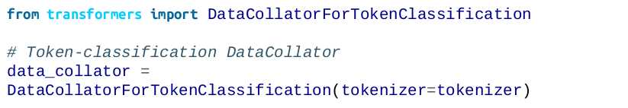
Fine-Tuning for Named-Entity Recognition
Instead of DataCollatorWithPadding , we need a collator that works with classification on a token level, namely DataCollatorForTokenClassification :
Now that we have loaded our model, the rest of the steps are similar to previous training procedures in this chapter.

Slide 53
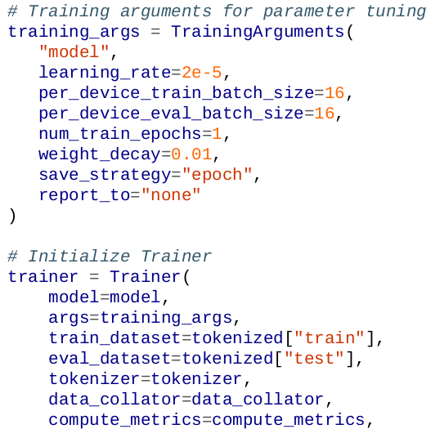

Fine-Tuning for Named-Entity Recognition
We define a trainer with specific arguments that we can tune and create a Trainer:

Slide 54
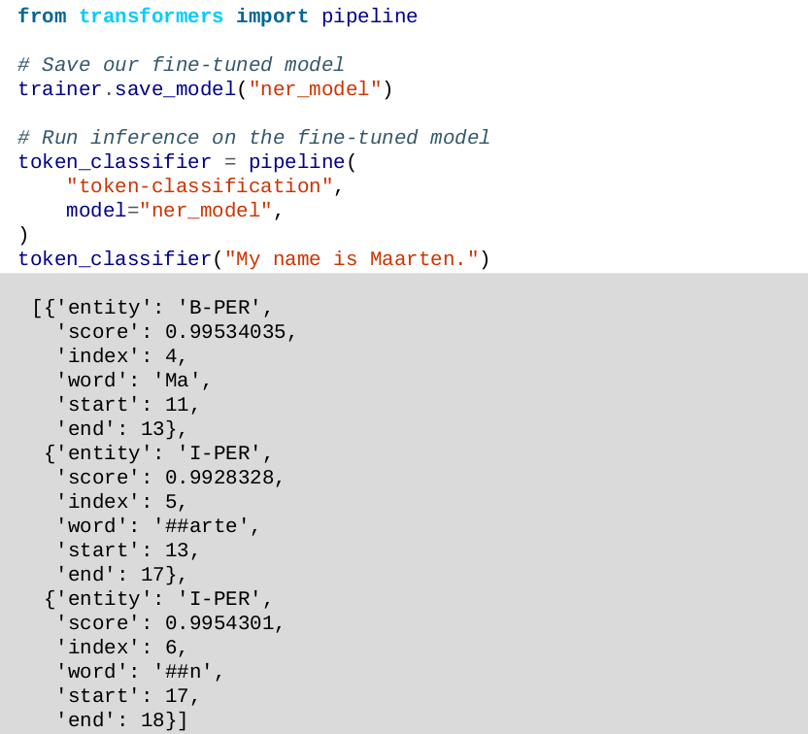
Fine-Tuning for Named-Entity Recognition
Lastly, let’s save the model and use it in a pipeline for inference.
In the sentence "My name is Maarten", the word "Maarten" and its subtokens were correctly identified as a person

Slide 55
END

